Slide 1
Fintech Industry Overview
谢绝转载，转载请联系WSFC
Wall Street Fintech Club

Slide 2
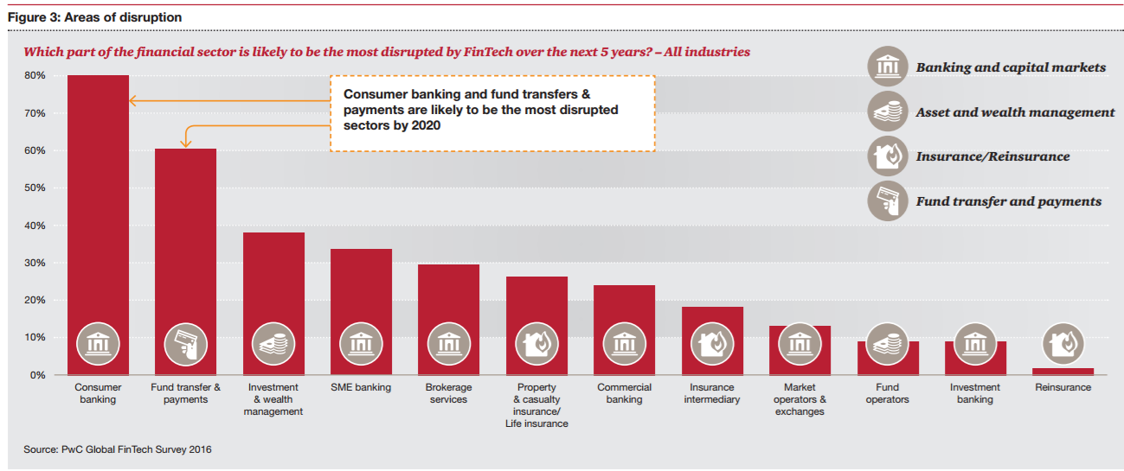
Disrupted Areas by Fintech Industry
来源：How Fintech is shaping Financial Services, PWC Global FinTech Report, Mar 2016

Slide 3
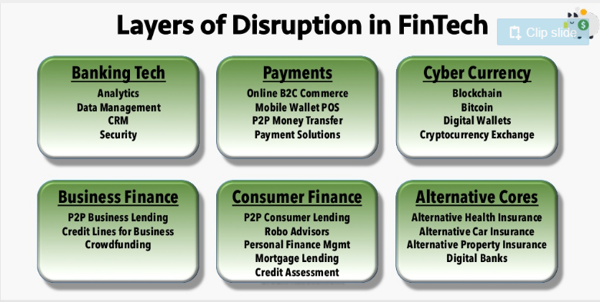
Fintech Subareas
来源：FinTech Industry Overview 2016, SparkLabs Global Ventures

Slide 4
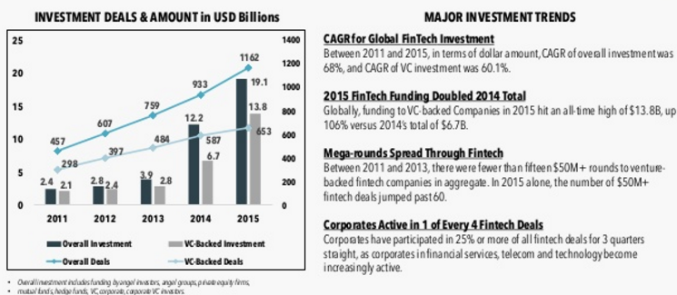
Fintech Investment Trend
来源：FinTech Industry Overview 2016, SparkLabs Global Ventures

Slide 5
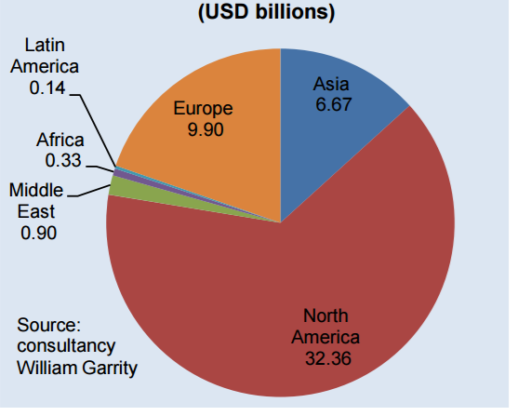
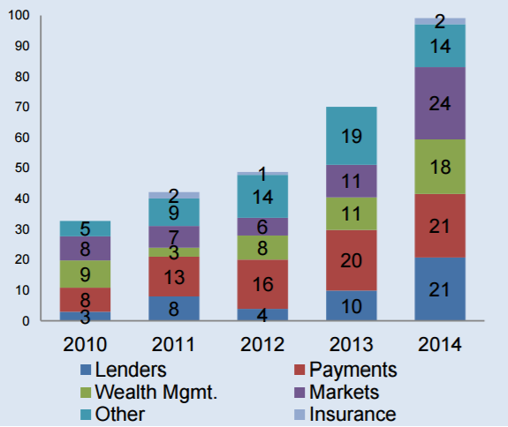
Fintech Investment Areas (Intl. Trade Admin)
2010-2014
# of Fintech Deals
--New York Area
来源：2016 Top Markets Report Financial Technology, International Trade Administration

Slide 6
Project Fintech Export Ranks
US excl.
Payment Area vs Overall
% of Financial Assets vs GDP
Internet Access
Smart Phone Access
Payment
Overall
来源：FinTech Industry Overview 2016, SparkLabs Global Ventures

Slide 7
Major Fintech Companies – US Consumer Lending Startups
Company Name | Business Outlines | Funding
SoFi [San Francisco, 2011] | SoFi is a marketplace that connects alumni borrowers and investors for reﬁnancing private and federal student loans. Investors get market returns, while borrowers get lower interest rates. Beneﬁts like events, career advising, seed funding and professional mentorship deliver value beyond a traditional bank. Also offers mortgages, mortgage reﬁnancing, and personal loans. Soﬁ has as over $7B in loans issued and more than 12k members. | $1.5 B
Avant [Chicago, 2012] | Avant is an online personal lending platform. It screens applications borrowers on the basis of FICO scores.The amount of principal lent is arrived at by taking into account income levels, credit history scores, and other criteria.Avant operates in 46 U.S. states and in the United Kingdom.Avant Institutional Marketplace enables qualiﬁed institutional investors the ability to purchase loans originated through the Avant technology platform.The company has raised more than $1B in debt.The platform has lent 3 billion dollars between 450,000 borrowers. | $655M
Affirm [San Francisco, 2012] | Afﬁrm is a millennial focused ﬁnancing platform offering Point of Sale loans to online shoppers. Its proprietary underwriting model processes borrower's data, sourced from merchant's website via an API, along with data points from alternative sources, like social networking websites, to arrive at a credit decision.The company monetizes from the interest charged on the loans and the processing fee charged from merchants. It also offers a single usage credit card which can be used at non-partner merchants' websites. | $420M
来源：FinTech Industry Overview 2016, SparkLabs Global Ventures

Slide 8
Major Fintech Companies -- US Consumer Lending Startups
Company Name | Business Outlines | Funding
LendUp [San Francisco, 2012] | LendUp is a direct lender and has created a product that allows small-dollar loans as an opportunity for consumers to build credit and move up the ﬁnancial ladder. Consumers who have poor or no credit can apply for and receive small-dollar, short-term loans. LendUp uses big data to do instant risk analysis and evaluate credit worthiness. Incubated at Y Combinator in Winter 2012. In April 2014 it launched its API using which other companies and organizations can integrate LendUp’s loan-processing tools into their own product, or even build their own ﬁnancial and loan service with a white-label option. In 2015, the L Card, a credit card business, launched in beta. | $164M
CommonBond [Brooklyn, 2011] | CommonBond is a B2C lending marketplace that allows students to ﬁnance their education or reﬁnance their student loan debt.The principal amount available for borrowing extends up to $220,000, with ﬁxed and ﬂexible interest rates available for repayments.The portal charges no fee for prepayment of the amount. | $147M
Earnest [San Francisco, 2013] | Earnest is a lending platform for students that provides an opportunity to lower education debt. The platform offers loans that have ﬂexible terms such as unemployment protection, an option to switch between ﬁxed and variable rates, and deferring payments to a later date in the investment term. The portal does not charge any origination or prepayment fees, and claims to earn its revenue from the interest charged. It also offers personal loans for various reasons like career development, vacations, wedding rings etc. | $107M
来源：FinTech Industry Overview 2016, SparkLabs Global Ventures

Slide 9
Major Fintech Companies – US Robo Advisor Startups
Company Name | Business Outlines | Funding
Betterment [New York, 2008] | Betterment is a goal-based online investment company that allows users to select how much they want invested in stock and Bonds ETFs. No minimum deposit to open an account.The management fees charged range from 0.15% to 0.35% based on the account balance.The company also offers a B2B2C platform for RIAs and a 401(K) investment platform. | $205M
Wealthfront [Palo Alto, 2008] | Wealthfront is an automated investment management service that uses modern portfolio the ory to deliver long-term returns. Low cost ETFs are used to represent each asset class. Stock allocations include US, foreign and emerging markets. Likewise, bond allocations include municipal, corporate and emerging markets.Alternative allocations in real estate and natural resources. | $129M
Motif Investing [San Mateo, 2010] | Motif is an online investment platform that enables users to create a basket (called a motif) of stocks and ETFs. Once built, an investor can buy a motif of up to 30 stocks and ETFs for $9.95. Investors can create their own motifs, invest in motifs built by Motif Investing, or invest in motifs built by other investors on the platform. Customers can start with $250 investment.Also provides a free service called Horizon motifs which are motifs comprised of low-cost ETFs. | $126M
Personal Capital [Redwood City, 2009] | Personal Capital offers two distinct services.The online and mobile portfolio tracking application downloads user's holdings in different accounts, aggregates and analyzes them into tables and charts. Helps user view all accounts in one place and is a free service. Second service offers to manage users' investment account. Users get a live person as advisor. | $104M
来源：FinTech Industry Overview 2016, SparkLabs Global Ventures

Slide 10
Major Fintech Companies – US Commercial Loans
Company Name | Business Outlines | Funding
Biz2Credit [New York, 2007] | Biz2Credit is a multi solution credit source for small businesses.The platform offers credit products such as SBA loans, traditional bank loans, business lines of credit, equipment ﬁnancing, business acquisition loans, commercial real estate loans, reﬁnancing and merchant cash advances.The amount borrowed from the platform can rage from $5,000 to $5M. Biz2Credit charges borrowers an underwriting fee once a loan has been successfully granted. Biz2Credit has arranged for $1.2 billion worth of credit for over 100,000 companies. | $250M
Kabbage [Atlanta, 2009] | Kabbage is a provider of working capital loans for small businesses. It leverages data generated through business activity such as seller channels, social media, shipping data, and other sources to understand performance and delivers ﬁnancing options for small businesses.The loans are made by Celtic Bank. In addition to this, Kabbage also provides white label platforms to companies wanting to start their own lending platforms. In 2015, it launched a white-label offering where third parties will power loan services using Kabbage’s technology. | $240M
OnDeck [New York City, 2007] | OnDeck is a technology powered lending company for SMBs. It leverages electronic information including online banking and merchant processing data to identify the creditworthiness of small businesses. Repayments are made through ﬁxed daily deductions from the business bank account and the loans are usually secured by liens on business assets and personal guarantee. Loans range from $5k to $250k.To date, OnDeck had funded more than $4 billion in loans since its inception. | $198M
来源：FinTech Industry Overview 2016, SparkLabs Global Ventures

Slide 11
Major Fintech Companies – US Commercial Loans
Company Name | Business Outlines | Funding
Behalf [New York, 2011] | Behalf is an alternate lending platform that offers a line of credit for purchases to businesses.The platform does not disburse any credit to the borrower, it instead handles the purchase requirements of the borrowers by dealing with their vendors directly.This principal of operations mitigates any mismanagement of funds by the borrower. | $129M
LendingHome [San Francisco, 2013] | Lending Home is an online mortgage marketplace for real estate loan borrowers, investors, and brokers. It allows both institutional investors and accredited retail investors to invest on its platform. Institutional investors including hedge funds, private equity, mortgage desks, family ofﬁces, university endowments can start investing with a minimum investment amount of US$10,000 and retail investors from US$1,000. Lending Home is a direct lender and sells whole loans to institutional or retail investors. | $109M
Super G Funding [Newport Beach, 2008] | Super G Funding is a national provider of business ﬁnancing solutions with loans ranging in size from $100,000 – $5,000,000. Super G makes loans up to ﬁve times the value of an ISO’s revenue stream, with a maximum value of $2 million. Revenues streams include core processing revenues and recurring fee revenues from terminal leasing, prepaid cards, and gateway and check-guarantee services. ISOs can take loans for 12, 24, or 36 months on which they are typically charged an interest rate between 17% and 19%. | $100M
CAN Capital [New York City, 1998] | CANCapital is a credit source for small businesses, the portal offers term loans and merchant cash advances to borrowers.The business loans can range from $2,500 to $150,000 for a term not exceeding 24 months.The merchant cash advances are future credit card sales bought by the platform at a discount, and are repaid in as a percentage of sales weekly.The company has been in operation for seventeen years and funded over 156,000 small businesses. | $93M
来源：FinTech Industry Overview 2016, SparkLabs Global Ventures

Slide 12
Major Fintech Companies – US Payment Solutions
Company Name | Business Outlines | Funding
Stripe [San Francisco, 2010] | Stripe is an online and mobile payment transaction processor. It provides APIs to help businesses accept various modes of payments from the latter's customers.The main products offered by Stripe are Stripe Checkout – an online and mobile payment gateway API, Stripe Connect – a white label payment API aimed at resellers and third party payment gateways, developer APIs – available in multiple languages. Its proprietary product stripe.js, is one of the earliest to allow merchants and businesses to accept payments on their sites without meeting the necessary PCI compliance requirements, as the card details are securely stored in Stripe’s servers instead of merchants’. | $300M
Coinbase [San Francisco, 2012] | Coinbase is a bitcoin wallet and platform where merchants and consumers can transact in bitcoin. Coinbase offers an exchange for Bitcoins, payment gateway for online merchants to accept Bitcoins and also provides APIs for developers.As of March 2016, the company claims to have served 3.4M customers from 32 countries and exchanged approximately $3.5B. It offers a mobile wallet and also provides Insurance protection for coins stored on their servers. | $106M
Vanco Payment Solutions [Atlanta, 2007] | Vanco Payment Solutions, earlier known as Veracity Payment Solutions, offers specialized payment solutions across multiple industries, including faith-based organizations, nonproﬁts, and professional services companies.The services offered include (a) payment gateway services - including credit/debit card processing, issue of prepaid gift cards, mPOS, web and text based donations, payment hardware services including POS terminals and card readers. | $80M
来源：FinTech Industry Overview 2016, SparkLabs Global Ventures

Slide 13
Major Fintech Companies – US Payment Solutions
Company Name | Business Outlines | Funding
WePay [Palo Alto, 2008] | WePay has built its API speciﬁcally for platform businesses like marketplaces, crowdfunding sites and small business software.Through its proprietary Veda social risk engine,WePay gives platforms a ﬂexible payments API that provides a great user experience while still being able to take on all their fraud risk and compliance burdens. WePay has processed transactions for more than 200,000 customers and 280+ partners. | $73M
Braintree [Chicago, 2007] | Braintree provides developers a full-stack platform to accept payments on their website and app. Provides hosted and API gateways to businesses.Also offers marketplace payment solutions, recurring billing and fraud protection services. Processes more than $10 billion annually (with more than $2 billion on mobile) for thousands of online and mobile commerce innovators including Airbnb, Fab, LivingSocial, OpenTable and Uber. Acquired by eBay's PayPal for $800M in Sep 2013. | $69M
BlueSnap [Boston, 2001] | Provides Hosted,API and hybrid gateways, business analytics and intelligence, recurring billing solutions.Works on intelligent routing to process payments faster, owing to its tie ups with multiple banks. It provides PCI level 1 security and compliance to its customers. In 2011, Boston-based private equity ﬁrm Great Hill Partners bought the company for $115 million. | $68M
2Checkout [Columbus, 2000] | 2Checkout is a PCI level 1 compliant payment gateway. Offers Hosted,API and shopping cart integrated gateways, with recurring billing and fraud prevention solutions (card data storage and three level encryption). Also provides mobile gateway solutions. Provides Sandbox for developers. | $60M
来源：FinTech Industry Overview 2016, SparkLabs Global Ventures

Slide 14
Major Fintech Companies – US Cyber Currency
Company Name | Business Outlines | Funding
Blockstream [San Francisco, 2014] | Blockstream works on the sidechains which are mutually interoperable blockchains and also work with Bitcoin, avoiding liquidity shortages, market ﬂuctuations, fragmentation, security breaches and frauds. Blockstream develops new crypto currencies, open assets and smart contracts.Their solutions cater to developers, asset issuers and users providing them with a neutral and cryptographically-assured computing technology for all their ﬁnancial needs. | $76M
Digital Asset Holdings [New York City, 2014] | Digital Asset builds distributed, encrypted STP tools for capital markets and ﬁnancial institutions. It develops technology that helps efﬁciency, transparency, compliance and settlement speed using cryptographic, distributed ledgers.Their offerings are 1) Open source distributed ledge infrastructure to create ledgers 2) Digital asset platform that interacts with ledgers and enable applications embedded with business logics in the form of low-level services 3) Business applications that are asset-speciﬁc plugins. | $60M
Chain [San Francisco, 2014] | Chain partners with leading organizations to build blockchain networks and apps.Their solutions enable institutions to design, deploy, and operate blockchain networks that can power any type of asset in any market . | $44M
来源：FinTech Industry Overview 2016, SparkLabs Global Ventures

Slide 15
Major Fintech Companies – US Digital Bank
Company Name | Business Outlines | Funding
Moven [New York City, 2011] | Moven is an alternative to traditional bank deposit. Provides mobile banking service where users have access to real-time updates and spending alerts, spending analysis across all their bank cards and credit cards, the ability to send money to friends from the app via Facebook, email or their mobile number. Its accounts and associated MasterCard debit card are backed by CBW Bank, an FDIC member based in Kansas.They have grown to 5,000 registered users and over 100,000 have signed up for invites. Managed over $300 million in customer spending. | $24M
Simple [Portland, 2009] | Consumer banking startup with a web/mobile interface that provides users with access to data around their ﬁnancial history, as well as tracking of expenditures and savings goals, with automated purchase data collected when its customers use their Simple Visa debit card. Simple is an intermediary between users and FDIC-insured institutions (Bancorp).Acquired by BBVA in February 2014, and will continue to operate separately, in parallel with BBVA's existing U.S. banking operations. | $15M
Chime [San Francisco, 2013] | Chime is a prepaid card and mobile banking account.The chime visa card is issued by Bancorp.The card can be used everywhere VISA card are used and comes with no minimums, overdraft fees or surprises.The account and related spending can be monitored with an associated mobile app. | $11M
来源：FinTech Industry Overview 2016, SparkLabs Global Ventures

Slide 16
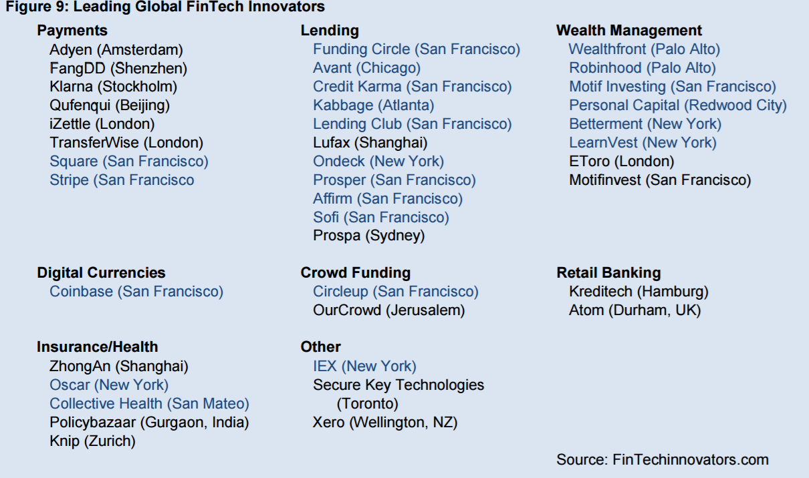
More to Come…
来源：FinTech Industry Overview 2016, SparkLabs Global Ventures

